Slide 1
Genetic Algorithm for the Routing Problem

Slide 2
Data Structure
Generation
Solution_list - List of solution objects
Origin - The node that starts and ends solutions
Routes - Total number of salesmen
Size - Total population in generation
Distance_Matrix
Class Functions
Get_best_solution - returns top performing solution in a generation
Remove_weakest_half
Generation_step - performs crossover and mutation steps
Solution
Routes - A list of the routes that constitute the solution
Score - Total distance traveled
Class Functions
Score_solution - builds the score of a solution
Mutate - Performs mutation on one solution
Valid_solution - Is the solution valid

Slide 3
Code Flow
Read in network data
Remove the weakest half from the population
Get the best solution and display
Build distance matrix
Mutate children
Initiate random generation of solutions
Perform Crossover on the generation

Slide 4
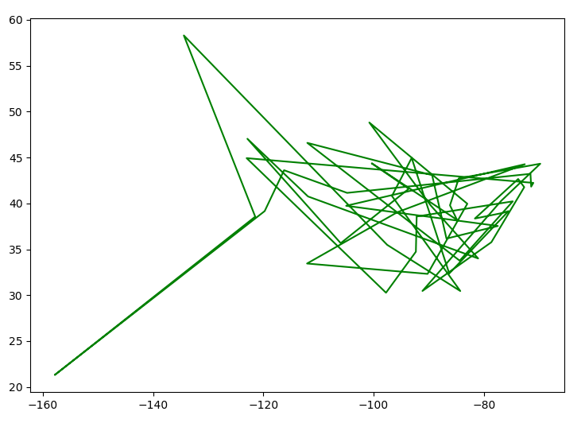
Best Solution - (Population: 2000, Generation: 0) 73477 km

Slide 5
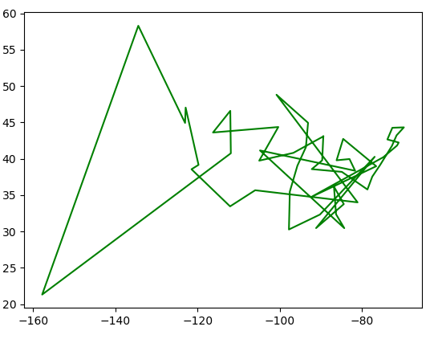
Best Solution - (Population: 2000, Generation: 400)
32282 km

Slide 6
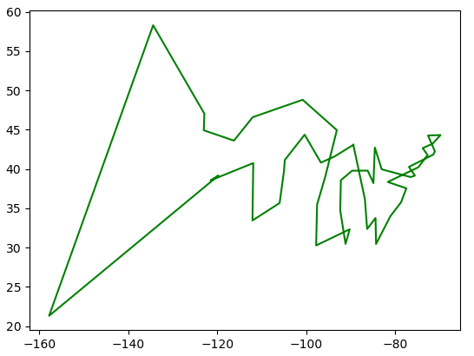
Best Solution - (Population: 2000, Generation: 800)
29361 km

Slide 7
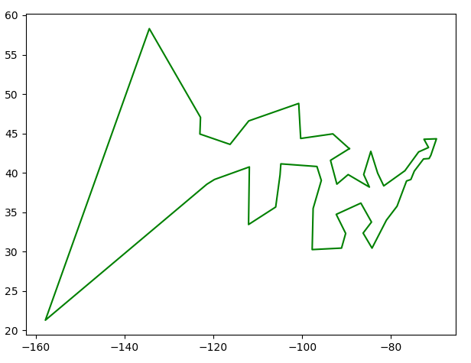
Best Solution - (Population: 2000, Generation: 1200)
28056 km

Slide 8
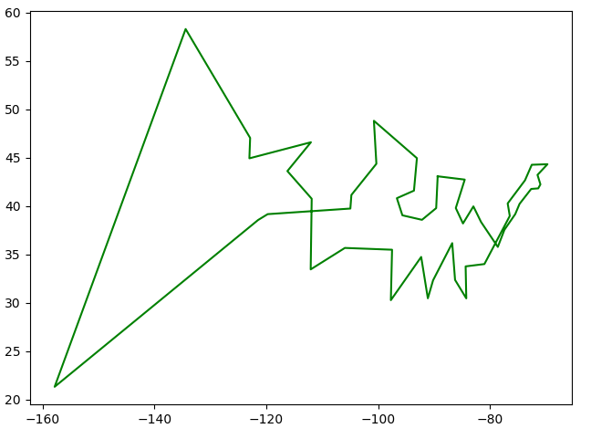
Best Solution - (Population: 2000, Generation: 1600)
27998 km

Slide 9
Best Solution - (Population: 2000, Generation: 2000)
26944 km

Slide 10
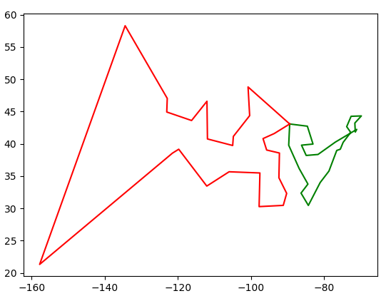
Best Solution - (Population: 2000, Generation: 2000, 2 routes)
27385 km

Slide 11
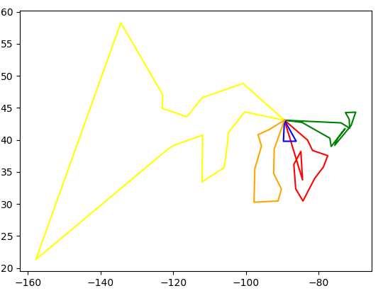
Best Solution - (Population: 2000, Generation: 2000, 5 routes)
32346 km

Slide 12
Thoughts on Genetic Diversity
There are three ways genetic diversity is introduced to the solution set. During the initial creation of random solutions, crossover step, and mutation.
Early in the algorithm the the initial random solution and crossover have a much larger contribution to genetic diversity compared to mutation.
As the solution set matures the main driver of genetic diversity becomes the mutation step.
It may be advantageous to increase the mutation chance as the solution matures to maintain an adequate level of genetic diversity.

Slide 13
Additional Notes
Check out the code on Github!
https://github.com/gregnetols/RoutingProblem

